Slide 1


CIB Marine
Specialised insurance, for vessel and cargo protection
MARINE

Slide 2
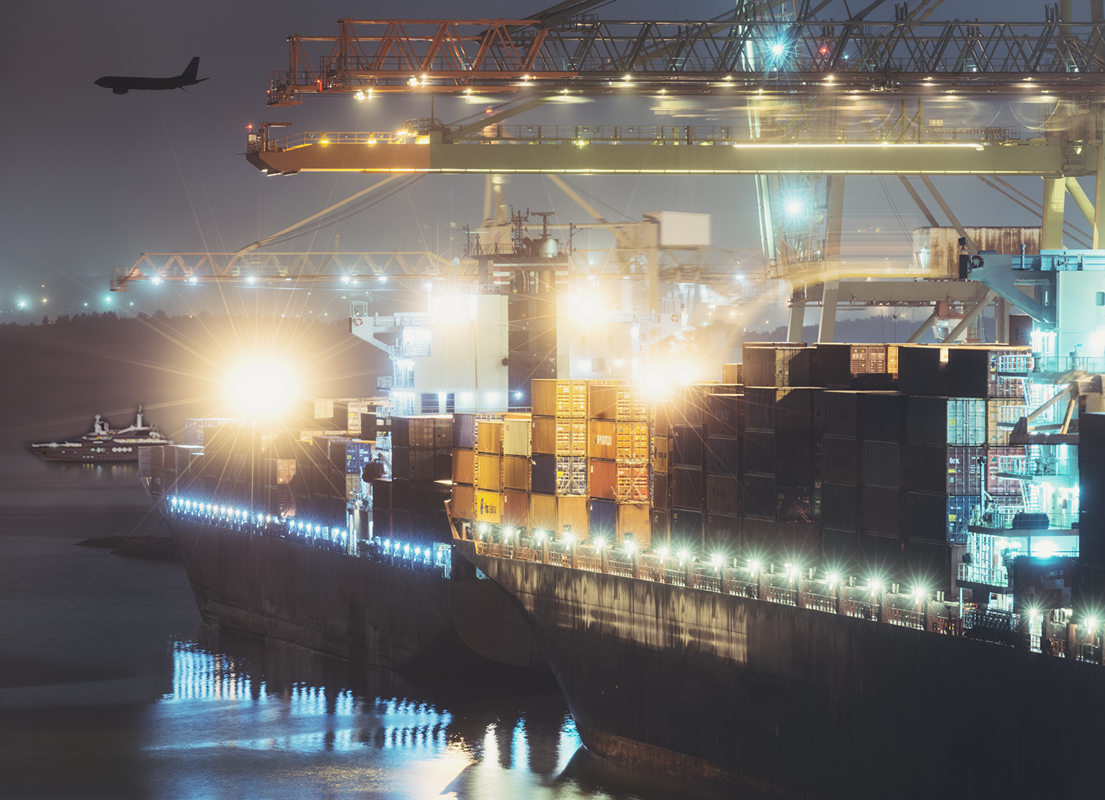
Marine Insurance is probably NOT the first thing that comes to mind when you think of protecting your business from risk.
MARINE

Slide 3



BUT
Do you import or export finished goods, parts or raw materials?
Is your business involved in manufacturing?
Distribution?
MARINE

Slide 4

If the answer is
YES
to any of these, then chances are you’ll be faced with the prospect of transporting goods at some point.
MARINE

Slide 5

And you’ll have to deal with all the risks and complexities this entails.
MARINE

Slide 6
Marine Insurance in its simplest form covers:
loss or damage
caused to ships, terminals, and any transport or cargo
whilst goods are in transit (or storage by special agreement)
between different points of origin and their final destination.
MARINE

Slide 7

When the concept was first conceived back in the time of the Ancient Greeks, rail, and air were not yet options to consider.
Modern marine cover encompasses all forms of transportation.
MARINE

Slide 8

For today’s captains of industry however, sea cargo is still a popular choice.
Not only for its low cost but because it can accommodate much more volume
than other modes of transport.
MARINE

Slide 9
Unfortunately, traversing the seas exposes your cargo to multiple
risks.
MARINE

Slide 10
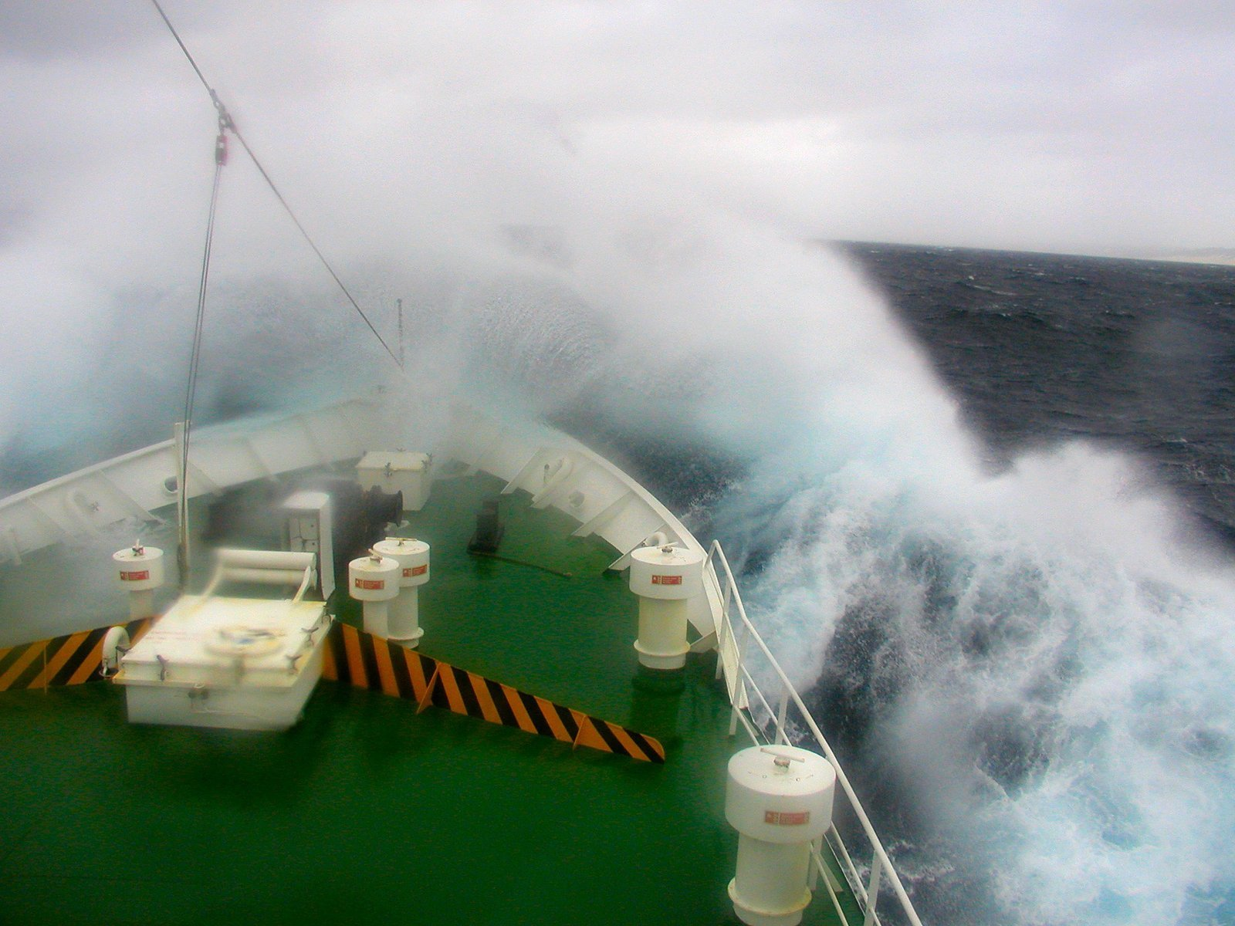

Even the best planned supply chain management is no contest for Mother Nature at her worst.
On a daily basis, ships (and your cargo) are subjected to all the perils of the sea.
These include storms, collisions,
stranding, and sinking.
Even normal wave action can result in violent movement of the vessel or the container, resulting in damage to your cargo.
And if that isn’t enough, incidents of piracy are still rife in certain parts of the world.
MARINE

Slide 11

These setbacks translate into additional pressures on your business that impact
negatively on your
bottom line.
Marine Insurance helps lower the aspect of financial loss due to loss of cargo and has become a welcome haven for transporters and cargo owners alike.
MARINE

Slide 12
And now we’re making it one for you…
With the launch of
CIB’s specialist Marine Division.
MARINE

Slide 13

Tapping into a wealth of localised expertise and global insights, CIB’s specialist Marine Division assists with structuring policies designed to help your business best navigate extraordinary circumstances.
MARINE

Slide 14
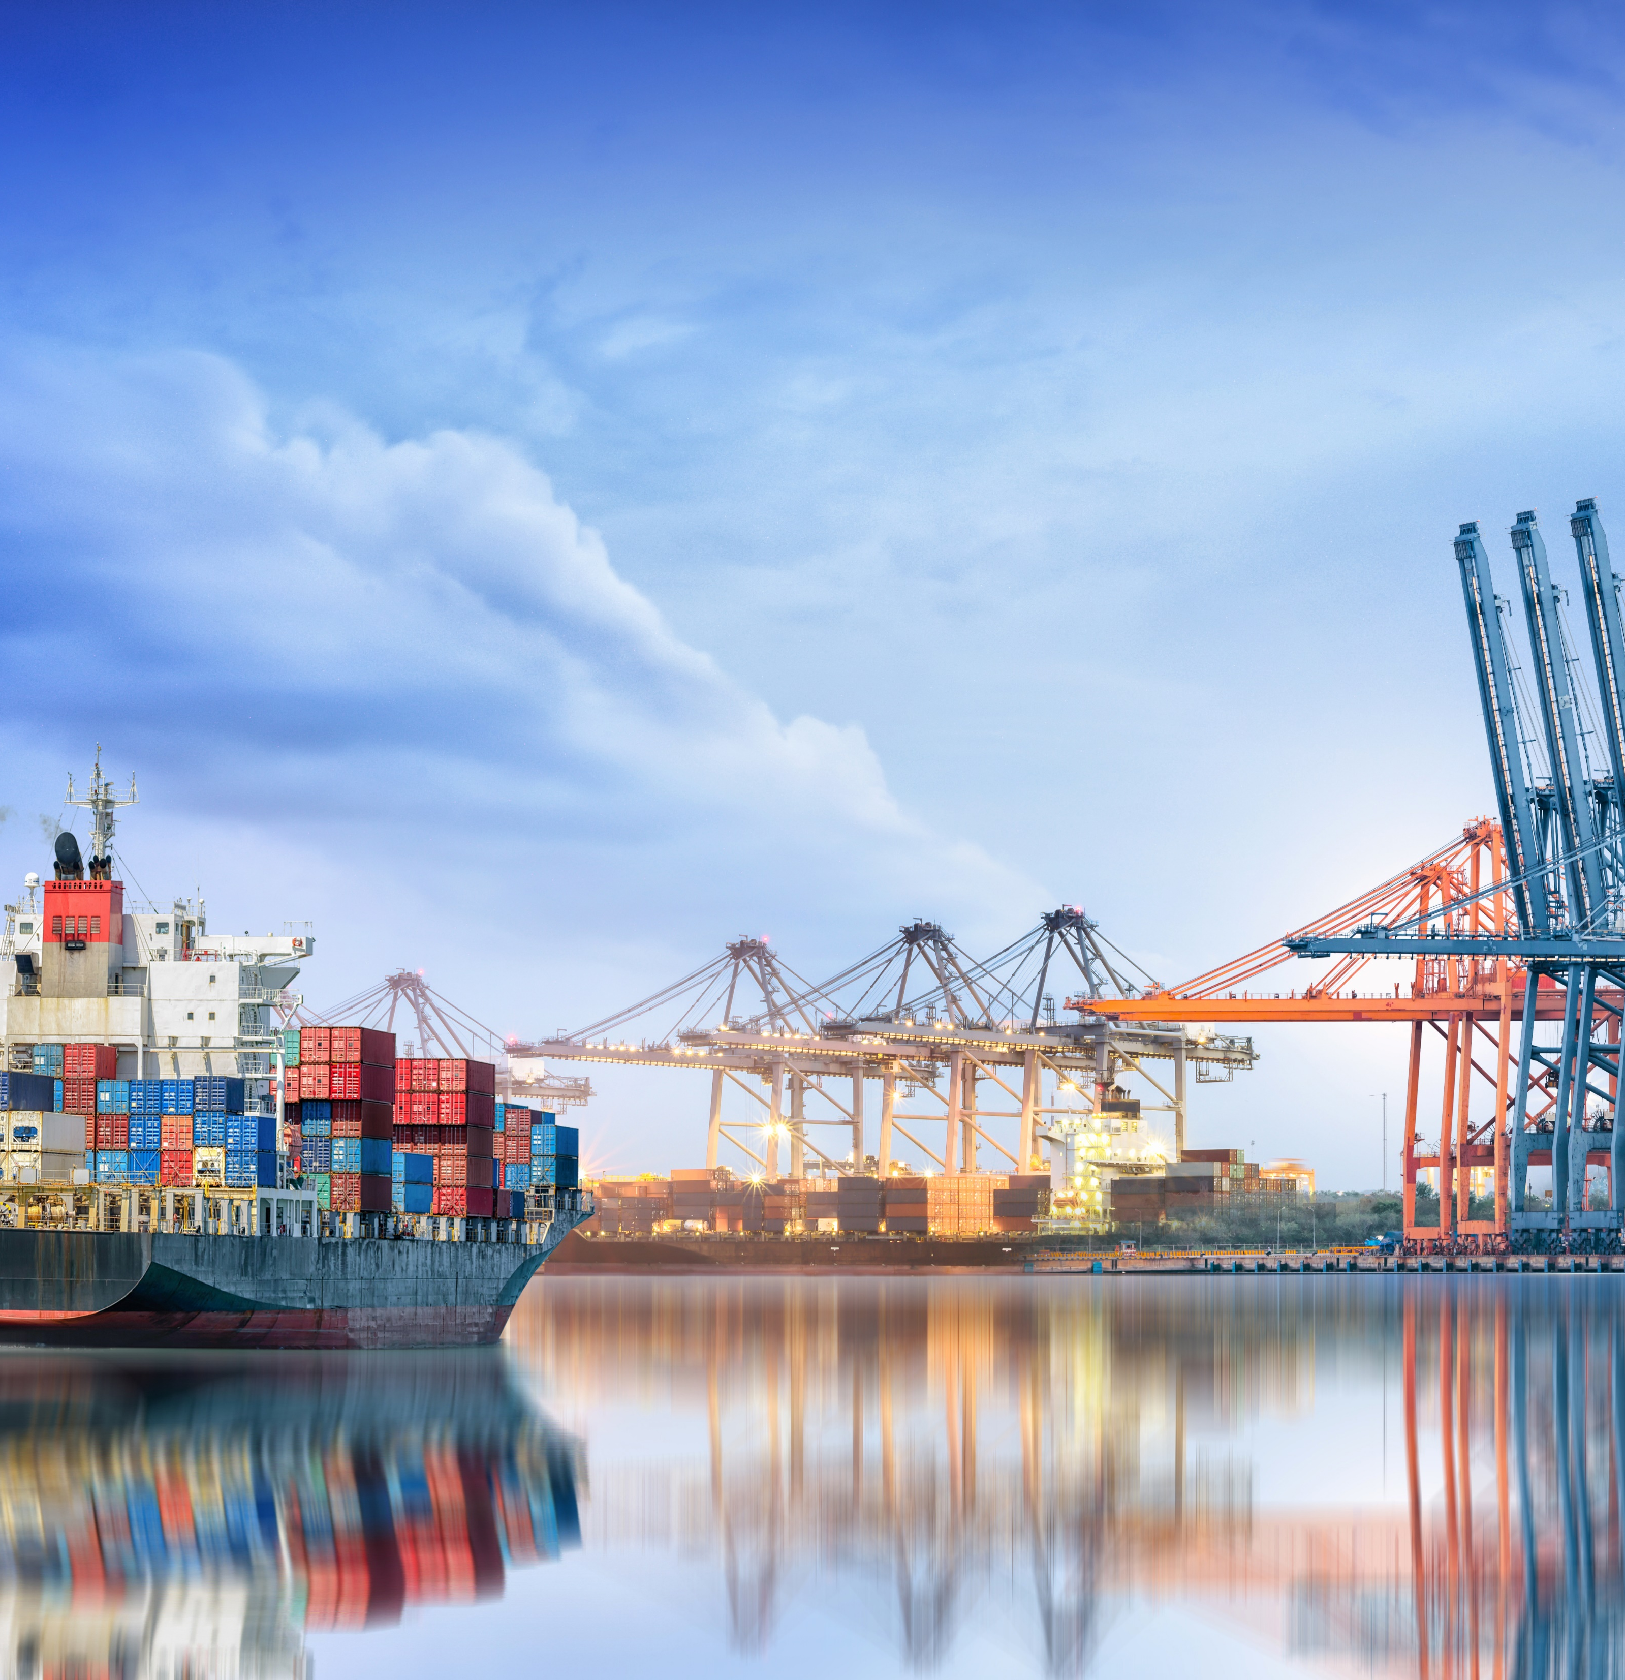
We tailor your cover based on your business requirements and risk profile, while accommodating the risks and associated protections required by marine clients, including:
Cargo /Goods in Transit Insurance
Advanced Loss of Profits (ALOP)/Delayed Start Up (DSU) for Project Cargo
Stock Throughput Covers
Marine Hull Insurance for Water Craft / Pleasure Craft used in a private and personal capacity as well as certain commercial vessels such as fishing vessels.
Marine Liabilities

Slide 15
So now your business can explore those uncharted territories, confident that you’re covered by someone you can trust.
MARINE

Slide 16

We understand your business.
A little more than we did yesterday.
And promise that however you grow,
your peace of mind is still top of ours.
MARINE

